Slide 1
D.I.S.A.R.M. Milestone 2
Debris In Space Autonomous Removal Mechanism
10/26/2020
Notes:
Lets get it

Slide 2
Content
PROJECT INTRODUCTION
MOTIVATION AND SCOPE
SYSTEM ARCHITECTURE AND REQUIREMENTS
CONTROLS SYSTEM
NEXT STEPS
Notes:
Lets get it

Slide 3
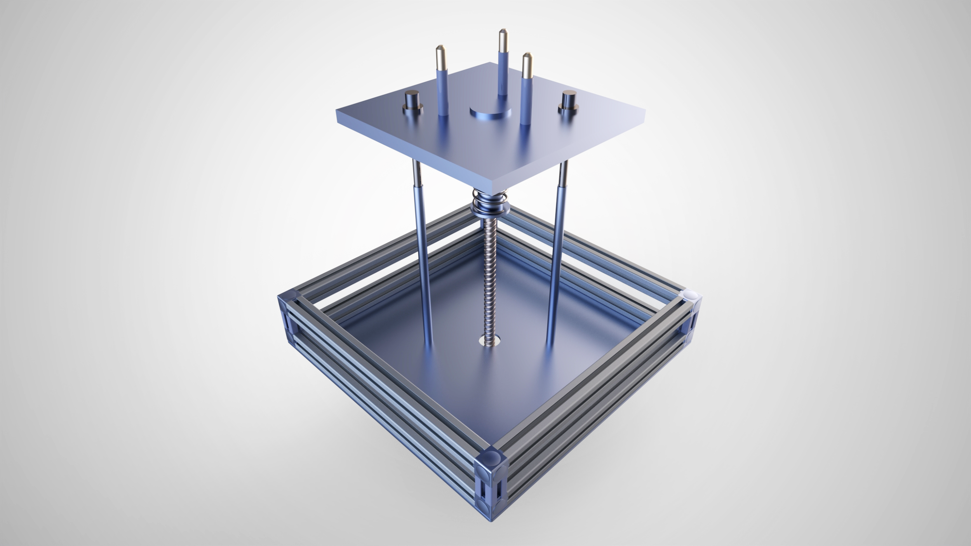
What is D.I.S.A.R.M.?
An autonomous,space debris grappling device that uses capacitor discharge stud welding as a form of attachment.
Model of the D.I.S.A.R.M. design.

Slide 4
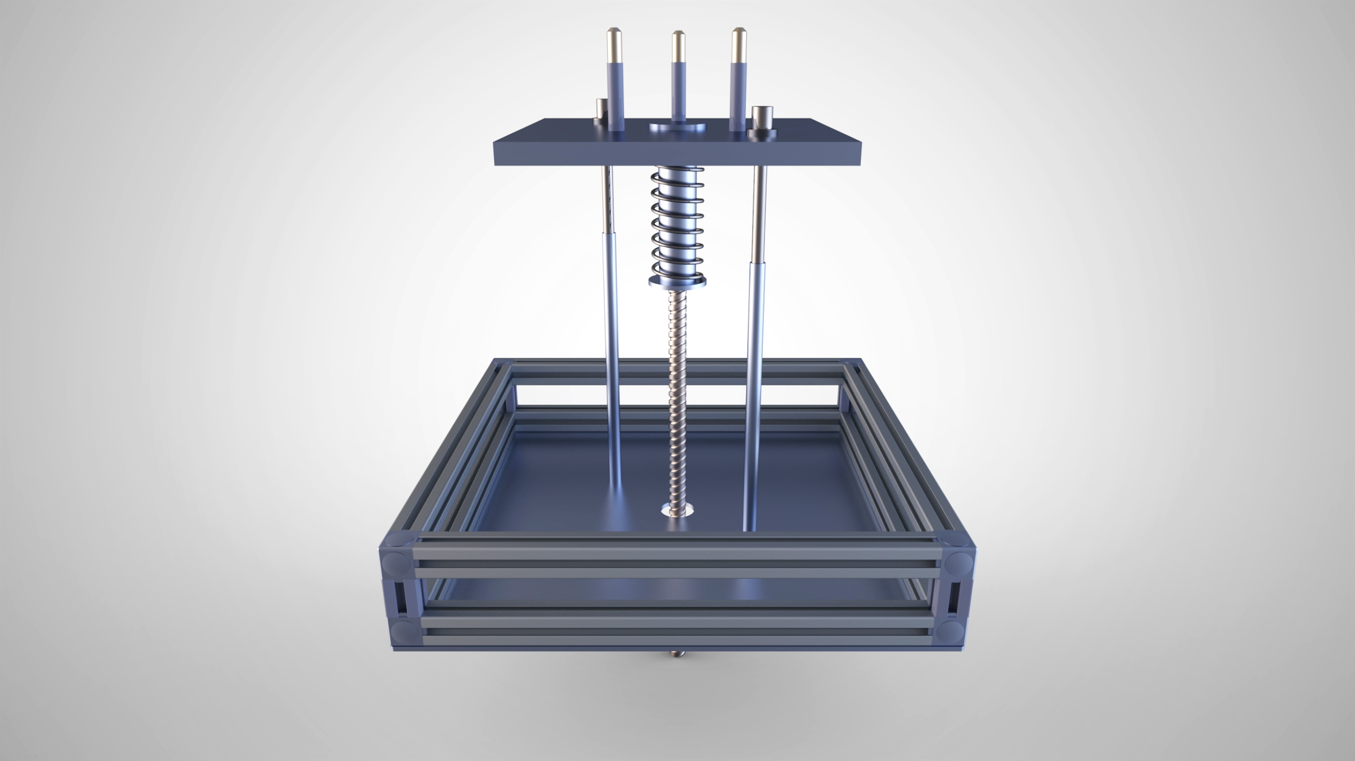
Welding Prongs
Upper Plate
Dampening spring
Guiding Rods
Outer Shaft
Electrical components housed in base
Driving Screw
Base
Labeled diagram of D.I.S.A.R.M.’s primary components.

Slide 5

Motive Behind D.I.S.A.R.M.
19%
MISSION RELATED DEBRIS
17%
ROCKET BODIES
There has been a huge increase in space debris in LEO.
This accumulation of space debris poses a threat to current and future space endeavors.
There is a need for an efficient and reliable grappling mechanism to be developed.
42%
FRAGMENTATION DEBRIS
22%
NON-FUNCTIONAL SPACECRAFT
*data sourced from NASA.
Notes:
Point 1

Slide 6
System Architecture and Requirements
D.I.S.A.R.M Milestone 2

Slide 7
Electronics
Grappling
Controls
Structures
Power Distribution
Attachment
Debris Sensors
Materials Selection
Onboard Computing
Welding Prongs
Control Logic
Shielding
Power/Data Transfer to Parent Sat.
Impact Dampening

Slide 8

SYS-01 = Autonomous.
SYS-02 = Weld shall withstand net forces.
SYS-03 = Weld the selected material to its melting point.
SYS-04 = Weld in under ten seconds.
SYS-05 = Withstand the conditions of space.
SYS-06 = Do not generate more debris.
SYS-07 = Compensate for the impact with the debris.
SYS-08 = Power and data transfer interface for the chaser satellite.
System Requirements
Notes:
Def need to consolidate this text

Slide 9
Control System
D.I.S.A.R.M Milestone 2

Slide 10
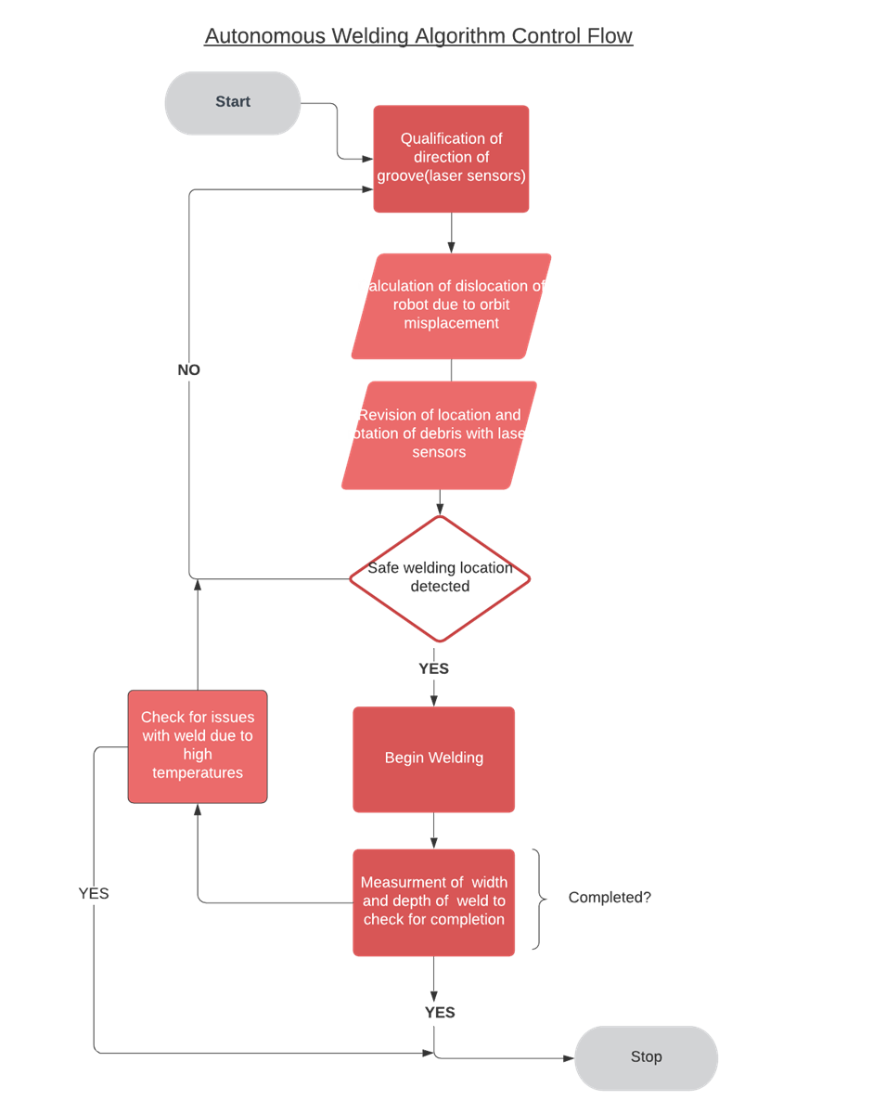

Slide 11
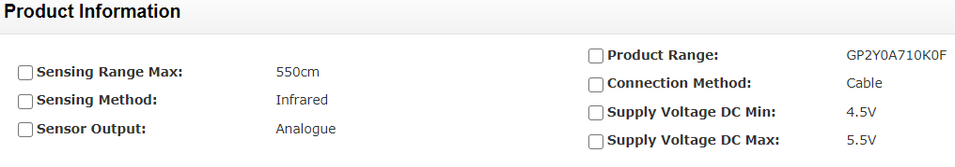
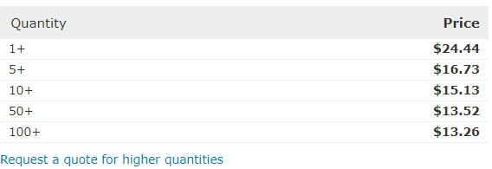
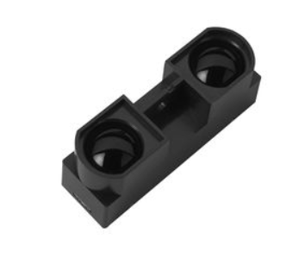
Possible Distance Detection Sensor (GP2Y0A710K0F)

Slide 12



Simulation of Control System

Slide 13
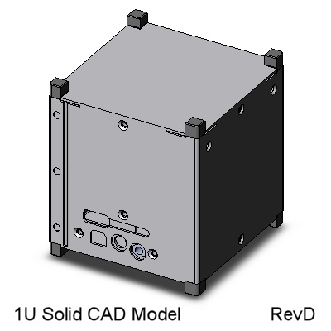
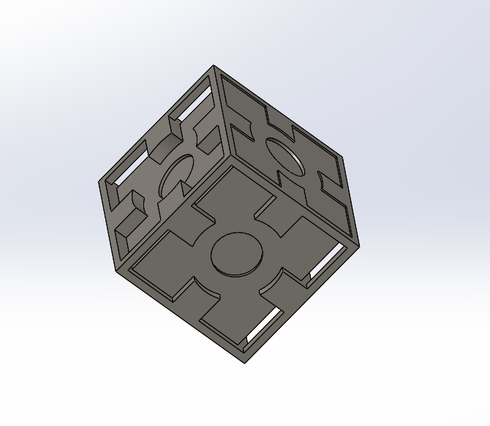
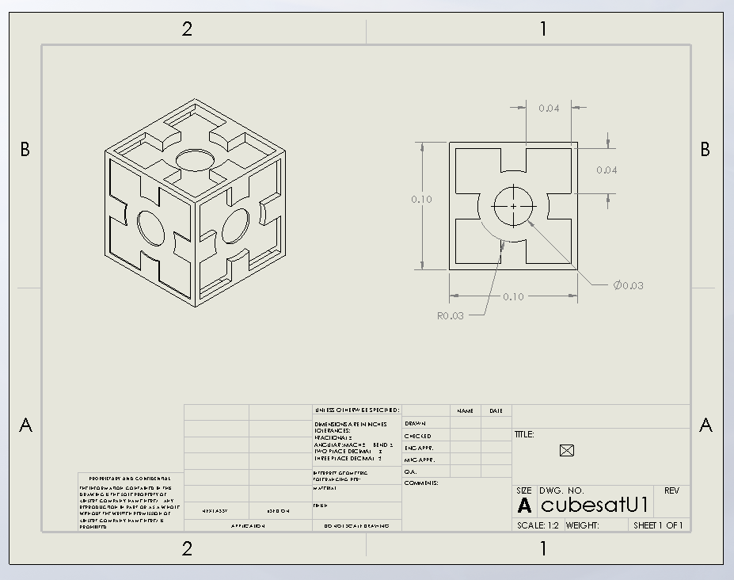
Space Debris Models (CubeSats)
 | 1U | 10U | 27U
Depth(m) | 0.015 | 0.15 | 0.405
Radius(m) | 0.001 | 0.01 | 0.027

Slide 14
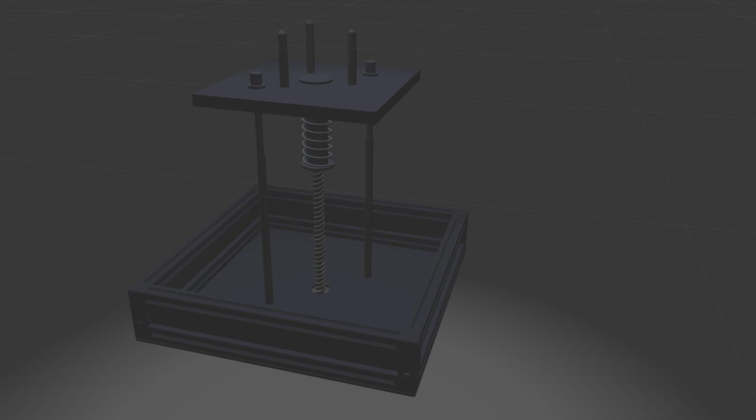
Current Gazebo Simulation Progress

Slide 15
Next Steps
Continue development of algorithm pseudocode
Implement pseudocode on Gazebo models
Simulate welding on Space Debris Model test cases

Slide 16

THANK YOU!
Kyle Watkins, Project Manager
watkinsk2017@my.fit.edu
Luca Rizza, Systems Engineer
lrizza2017@my.fit.edu
Laura Guziczek, Engineer
lguziczek2018@my.fit.edu
Michael Leard, Engineer
mleard2017@my.fit.edu
Ali Lebbar, Engineer
alebbar2016@my.fit.edu
Davey Renoid, Engineer
drenoid2016@my.fit.edu
Matthew Intriago, Computer Science
mintriago2017@my.fit.edu
Vincent Panichelli, Engineer
vpanichelli2017@my.fit.edu
Daniel Soto, Engineer
dsotoperezco2017@my.fit.edu
Nouraldean El-Chariti, Engineer
nelchariti2017@my.fit.edu

